Slide 1
ESTIMATION OF CROP YIELD USING DATA ANALYTICS
Team ID:PNT2022TMID18592
Domain: Data Analytics

Slide 2

Table of Contents
Introduction
Literature survey
Ideation and Proposed Solution
Project Design
Coding and Solution
Conclusion and Future Scope

Slide 3
Introduction
India is one of the major players in the agriculture sector worldwide and it is the primary source of livelihood for about 58% of India’s population. The discipline of agricultural information technology has recently undergone significant changes that have made crop yield prediction an exciting research topic. Crop yield prediction is a technique for estimating crop yield using many characteristics, including temperature, rainfall, fertilizers, insecticides, and other climatic variables and parameters. Using data analytics to analyze those parameters and provide the patterns or trends that have been followed over the past years in estimating the yield can help farmers to make the right choice in the selection of crop varieties, etc., To make the prediction results clearly we made a visualization in the dashboard and it is helpful in representing the results of the prediction to choose the appropriate crop.

Slide 4
Objective
To optimize the crop growth and yield
To predict appropriate crop yield using the data analytics techniques

Slide 5
Vision
Mission
Gain the self confidence among the farmers
Weather Prediction,
Analyzing the nature of soil,
High yield

Slide 6

Proposed Methodology
The idea is to find the salinity level of the soil and based on that we will be suggesting what crop will be grown in that land in order to get a good yield also we will be indicating the nutrients required so that the crop required to grow in that land. The uniqueness is that we will be finding the nutrient level of the soil and by the regression process we will say how much the nutrient is to be added.
The Customer that is farmer will feel stress-free and will avoid the tension of crop quality and help to avoid getting an unwanted loan. Since it’s just an app for getting information about the usage of land there is no business motive. But it can be added as a subscriptive pack for research purposes in the future.

Slide 7
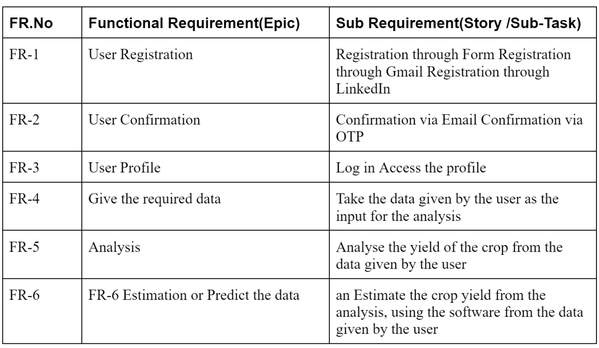

Functional Requirements

Slide 8
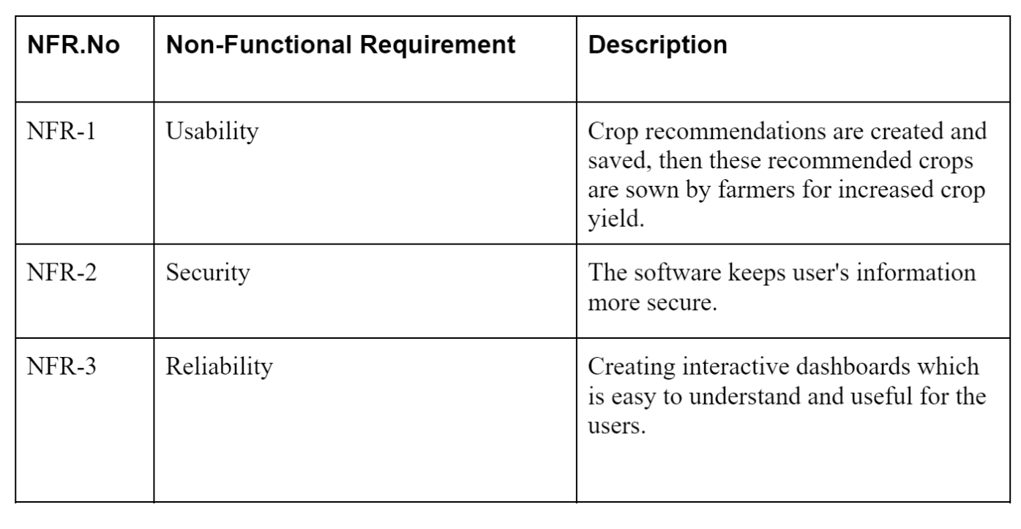
NON-Functional Requirements

Slide 9
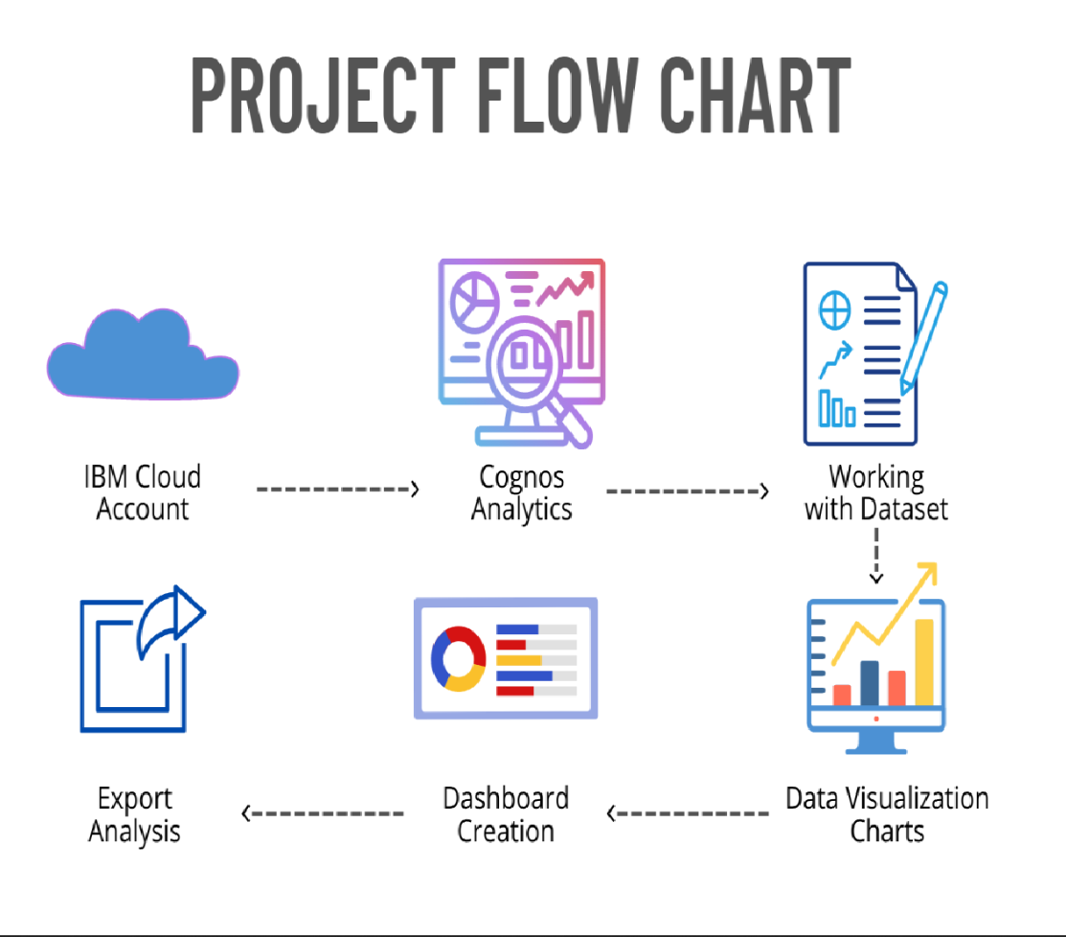
Project Design

Slide 10
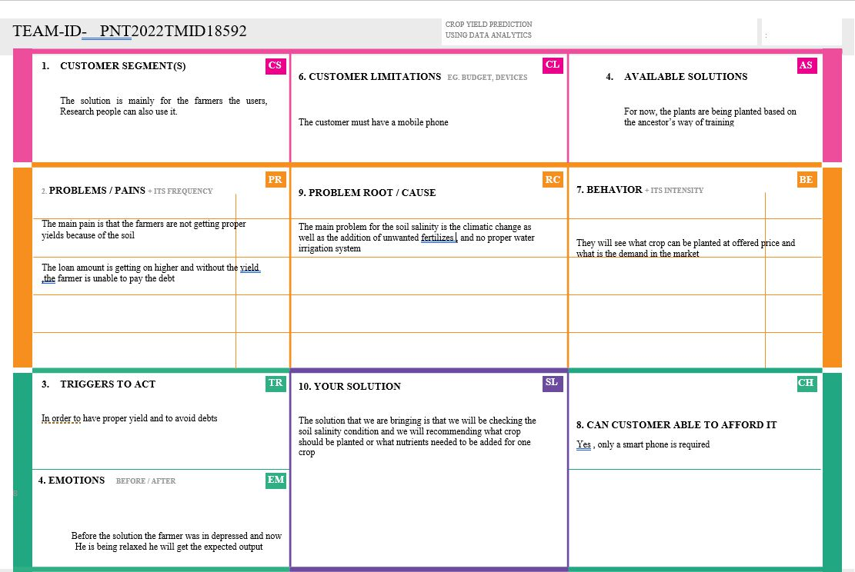
Problem Solution Fit

Slide 11
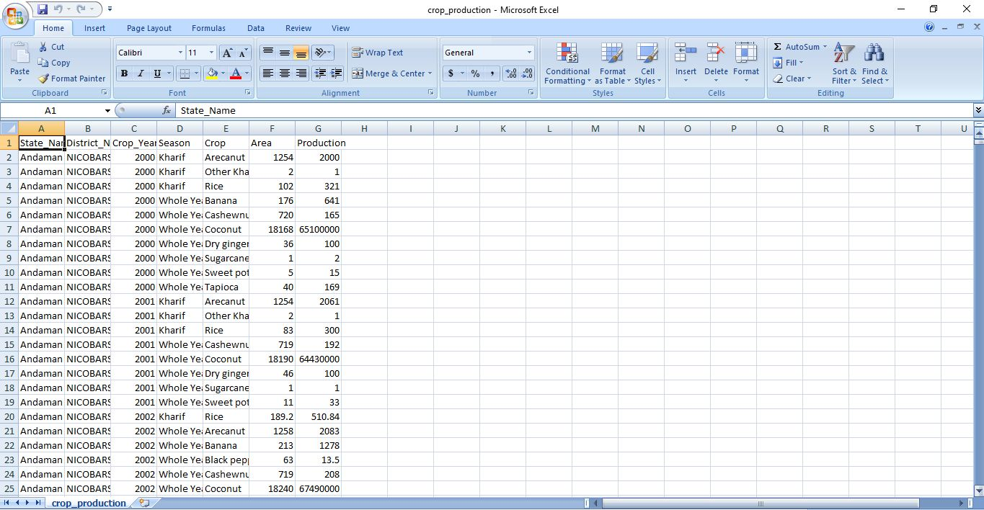
Working with Dataset

Slide 12
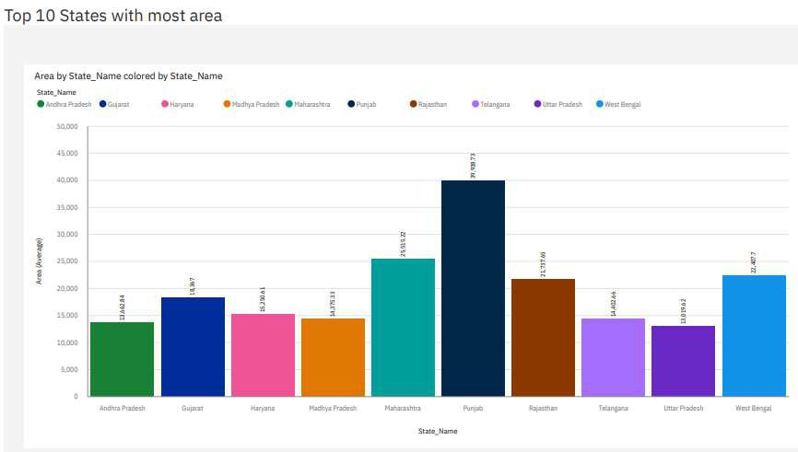
Visualizations

Slide 13
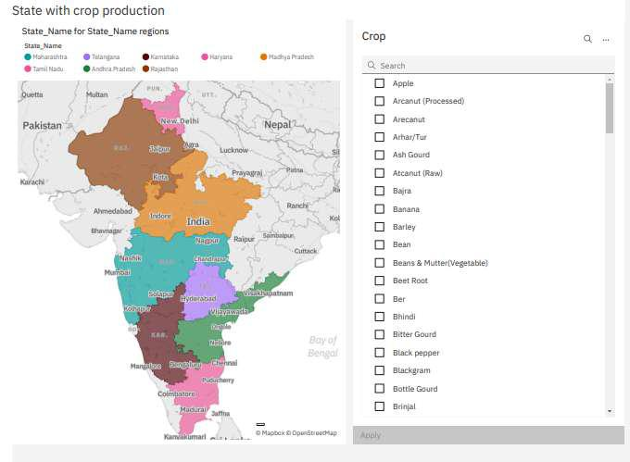

Slide 14
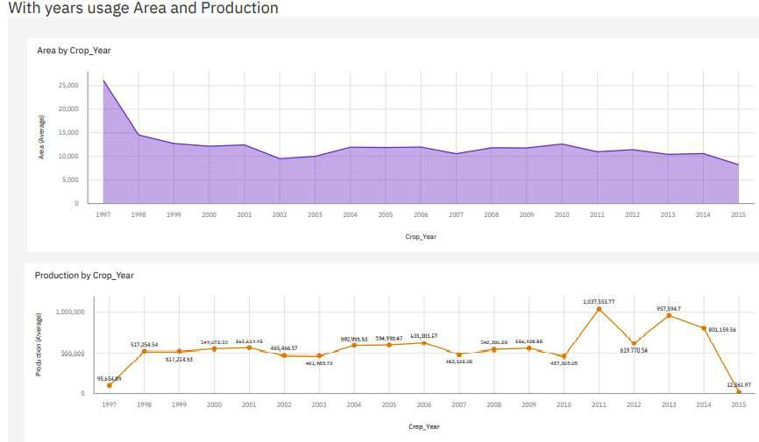

Slide 15
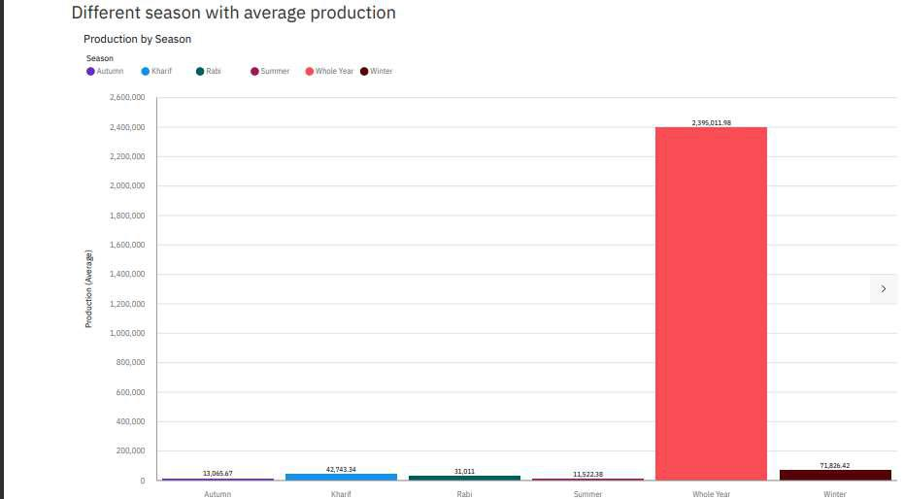

Slide 16
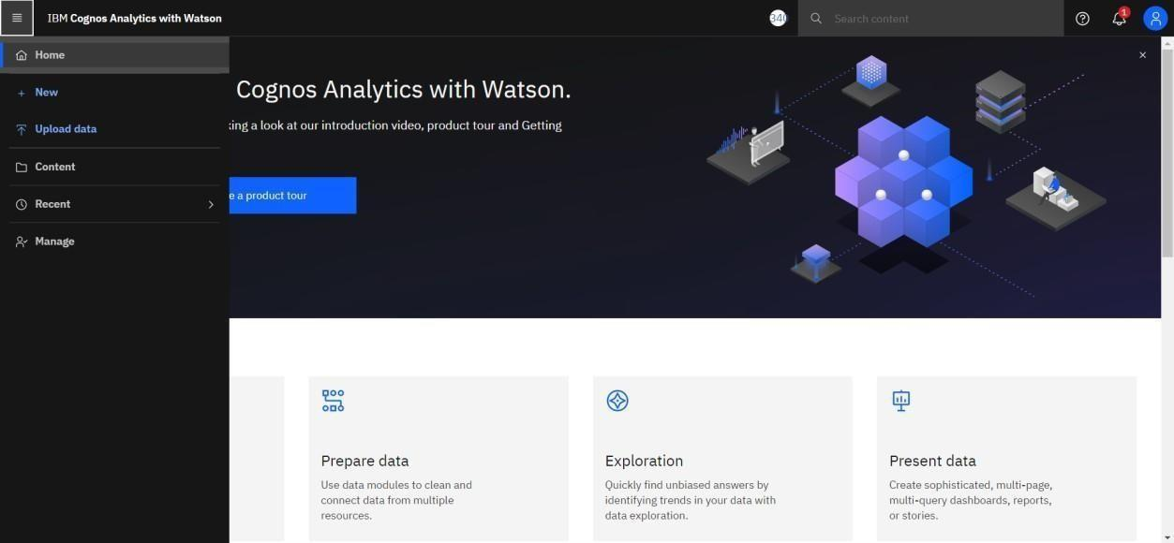
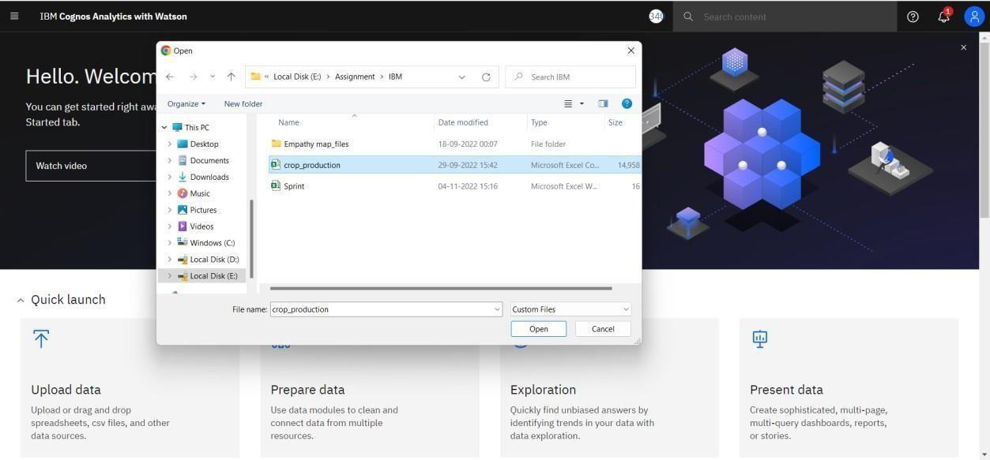
Creating Dashboard in COGNOS

Slide 17
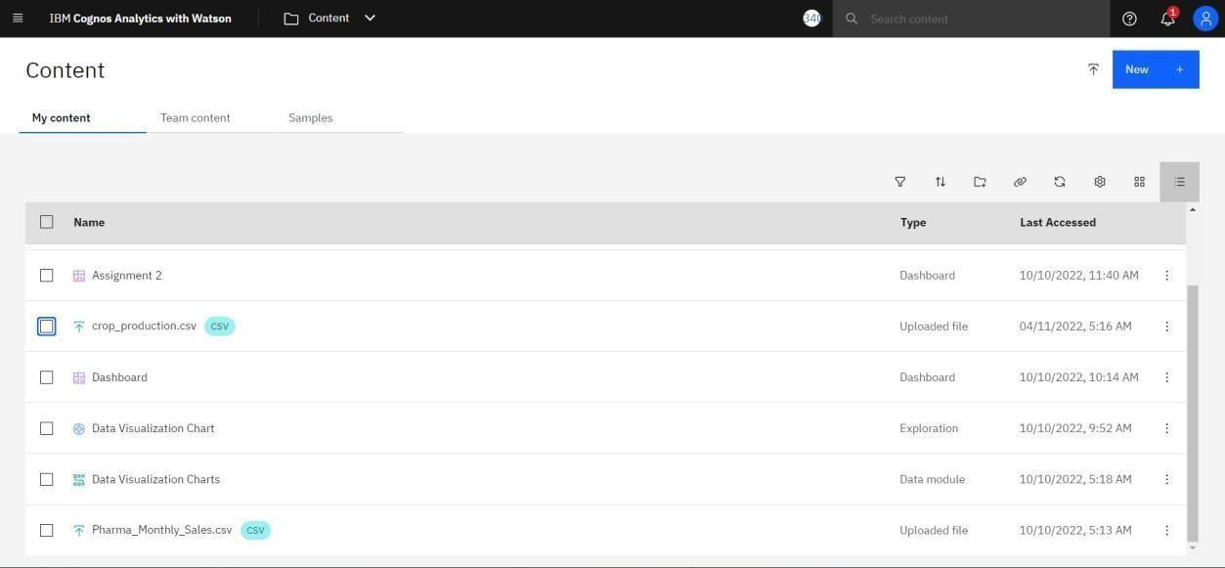

Slide 18
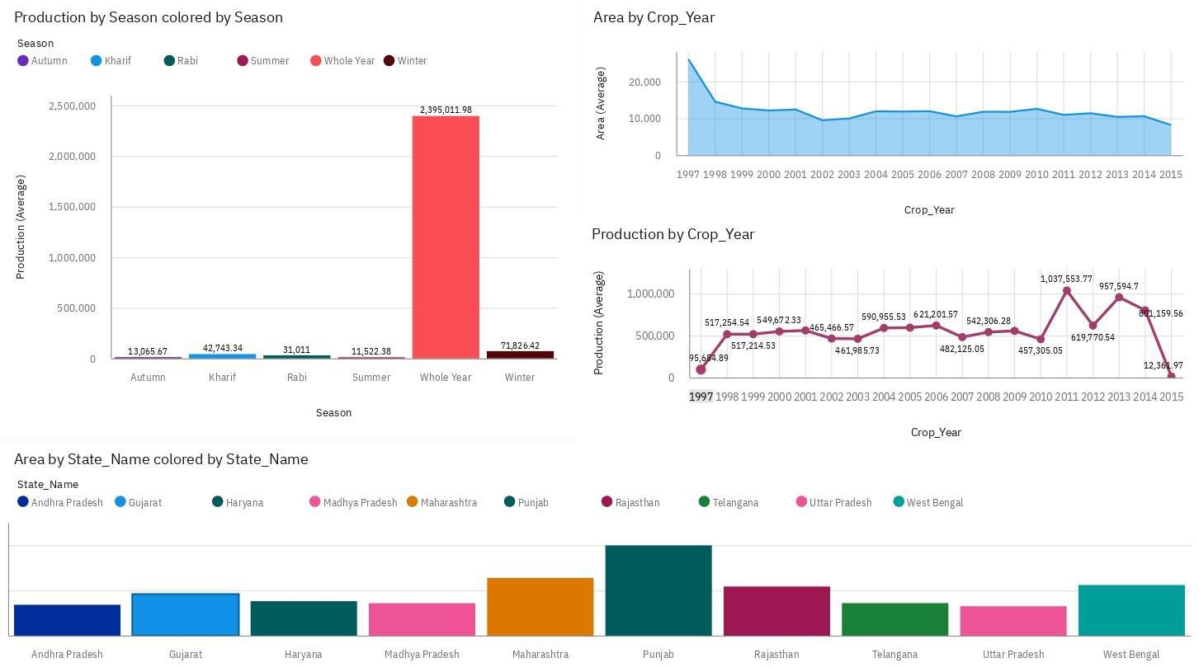

Slide 19
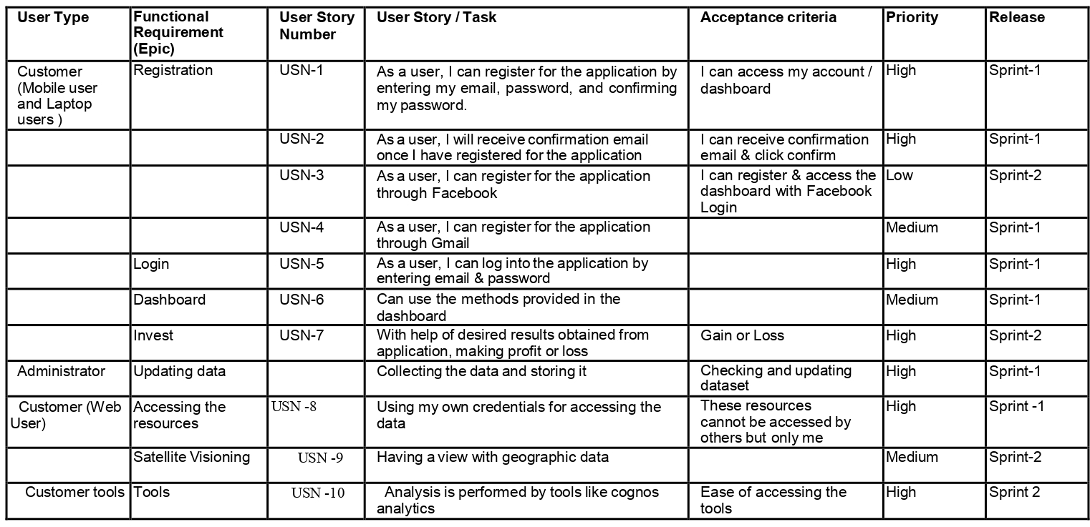
User Stories

Slide 20
Advantages and Disadvantages
Advantages
One can easily analyze and understand trends in cropping patterns, and seasonal behavior of land in various areas with the created dashboard. With no prior skills and knowledge about the tools that we use for analysis, anyone (literate or illiterate )can easily infer the knowledge that we represent in various charts or graphs, or maps. So that it would be helpful to farmers to make appropriate decisions in the future.
Disadvantages
Not all factors influencing the crop yield are being considered for the analysis as we have only taken visible factors into account for the analysis.

Slide 21
Conclusion
The productivity of agriculture has slightly increased as a result of technology's introduction. New ideas like digital agriculture, smart farming, precision agriculture, etc. have been made possible by innovations. From the analysis dashboard, it has been noted that analyses of agricultural productivity and the detection of hidden patterns utilizing data sets related to seasons and crop yields have been conducted. Using IBM Cognos, we have observed and conducted analysis on various crops grown areas, and productions in various states and districts, including
1) Seasons with average productions. We learn from these analytics which seasons have higher average production and which have lower production.
2)Production split up per crop year. We learn from this study which years have high and low production.
3) District-based production. With the help of these analytics, we may identify the states and districts that farm the chosen crops.
4) Production by area. This will allow us to estimate the yield and determine how much land needs to be planted. After creating the dashboard, the study was done to determine which state, which year, and how much crop area will be produced.

Slide 22
Thank You

